Slide 1
Introduction to Creation Platform

Slide 2
Creation Platform
Abstraction layer for the Core
Fully implemented in Python and KL
Collection of Registered Types
Common reusable features
Higher level “Node” concept

Slide 3
SceneGraphNode
SceneGraphNode
CoreNode
CoreNode
Scalar a
Scalar a
Scalar b
Scalar b
Scalar result
Scalar result
addOp
addOp

Slide 4
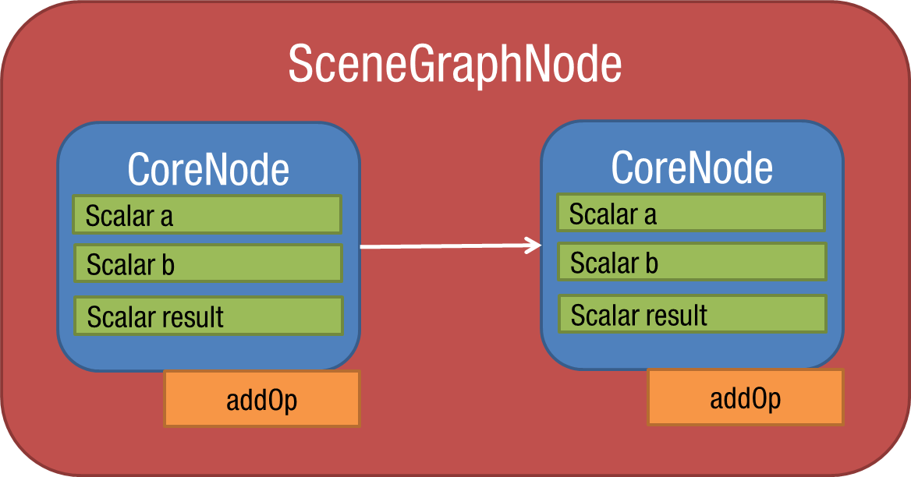
SceneGraphNode
High level node
Wrapping low level Dependency Graph
Node connection functionality
Extendable through Components

Slide 5
Application base classes
Provide all base application services
Specialized integration / standalone
Full persistence

Slide 6
Component
Adds Core elements to nodes
Example: Deformation pipeline

Slide 7
Break.... (third round of beers?)

